Slide 1



PERSONAL ASSISTANT
NAVEEN KUMAR
SRM Institute of Science and Technology

Slide 2

LITERATURE SURVEY
ScheduleME - Smart Digital Personal Assistant for Automatic Priority Based Task Scheduling and Time Management ,2021
ABSTRACT:
Managing assignments, projects, and personal chores has become challenging for university students. Existing tools like Trello and Asana require manual task entry and prioritization, making time management monotonous and inefficient. ScheduleME is a smart digital personal assistant mobile app that automatically collects, prioritizes, and schedules tasks based on a student’s academic and personal timetable. The app provides a user-friendly interface, presenting essential information without overwhelming the user, while allowing customization. Its key components include data engineering, intelligent task breakdown, personalized scheduling, and user-centered design. Advanced algorithms enhance task prioritization and optimize time management for improved efficiency and productivity.

Slide 3
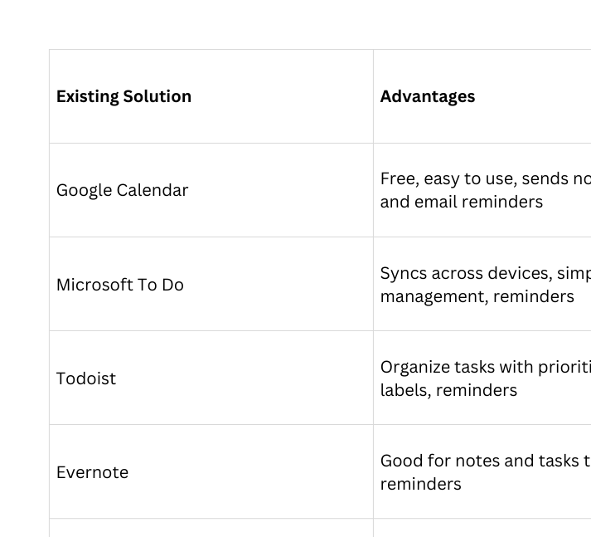
EXISTING SOLUTIONS

Slide 4
Java Technologies
Java SE (Standard Edition) – Core Java for building your application logic.
Java Swing – Library for creating simple graphical user interfaces (GUI).
JDBC (Java Database Connectivity) – To connect your program to a database (like MySQL) to store tasks and reminders.
Collections Framework – To manage tasks in memory using Lists, Maps, or Sets.
Threads / Timer – To create reminders and notifications at scheduled times.
File I/O – To save and load tasks in files if a database is not used.
Exception Handling – To handle errors like invalid input or missing files.
Java Classes & Objects – To represent tasks, reminders, and users.
Scanner / User Input – To read input from users for adding or updating tasks.
Simple Alerts / Dialogs – Using JOptionPane to show reminders or notifications.
TRL 1- BASIC PRINCIPLES OBSERVED AND REPORTED

Slide 5
Methodology / Approach
Step 1: Requirement Analysis
Identify what the system should do:
Add, update, delete tasks
Show tasks for today, week, or month
Remind the user about upcoming or missed tasks
Step 2: Design
Create a simple flow of the system:
User opens the application
User adds or edits tasks
Application stores tasks in memory (or a file/database)
Application checks task deadlines and sends reminders
Class Design:
Task class – stores task name, description, date, time, and status
TaskManager class – handles adding, deleting, and showing tasks
Reminder class – handles notifications
TRL 1- BASIC PRINCIPLES OBSERVED AND REPORTED

Slide 6
Step 3: Implementation
Use Java concepts:
Classes and Objects – to represent tasks
ArrayList – to store multiple tasks
Scanner – to take input from user
Loops & If-Else – to process tasks and check deadlines
Timer / Thread – to send reminders at the right time
File I/O (Optional) – to save tasks for later use
Step 4: Testing
Check if tasks can be:
Added, updated, deleted correctly
Reminders appear at the correct time
Test with multiple tasks and different dates
Step 5: Deployment
Run as a standalone Java application
User can interact via console or simple GUI (using Swing or JOptionPane)
TRL 1- BASIC PRINCIPLES OBSERVED AND REPORTED

Slide 7



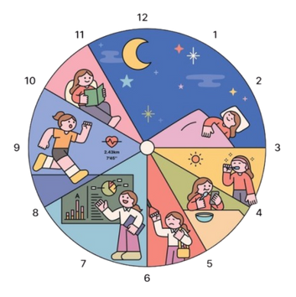


Key Findings/Results
Plan daily/weekly activities
Get task and assignment reminders
Receive missed-task notifications

Slide 8


